Slide 1
DBBC 2020

Slide 2
DBBC 2020
Where there is no prophetic vision the people cast off restraint, but blessed is he who keeps the law.
Proverbs 29:18

Slide 3
DBBC 2020
“You’ve got to see it before you see it; otherwise, you’ll never see it.”
Dr. Jack Graham

Slide 4
DBBC 2020
Why now?
Leading of the Holy Spirit
Unity of Leadership
Stewardship
Funding

Slide 5
DBBC 2020
Stewardship
Giving
Property
Proclamation

Slide 6
DBBC 2020
Church
Vs.
Place of Worship

Slide 7
DBBC 2020
Phase 1
Stage
Floor
Audio/Video
Painting
Lighting

Slide 8
DBBC 2020
Phase 2
Debt Retirement
Worship Center

Slide 9
DBBC 2020
Phase 3
Connect Buildings
Parking Lot
Plaza
Playground

Slide 10
DBBC 2020
Phase 4
To Be Determined

Slide 11
DBBC 2020
Phase 1 Budget
Stage $20,000
Floor $15,000
Audio/Video $10,000
Painting $10,000
Lighting $5,000
Total $60,000

Slide 12
DBBC 2020
Phase 2 Budget
Debt Retirement $195,000
Worship Center $130,000
Audio/Video $20,000
Chairs $12,000
Other $10,000
Total $367,000

Slide 13
DBBC 2020
Funding
Tithes
Offerings
One Time
6 Months
12 Months

Slide 14
DBBC 2020
Phase 1 Funding
Current Operating Cash

Slide 15
DBBC 2020
Phase 1 & 2 Funding
Excess Tithes
Offerings
One Time
6 Months
12 Months

Slide 16
DBBC 2020

Slide 17
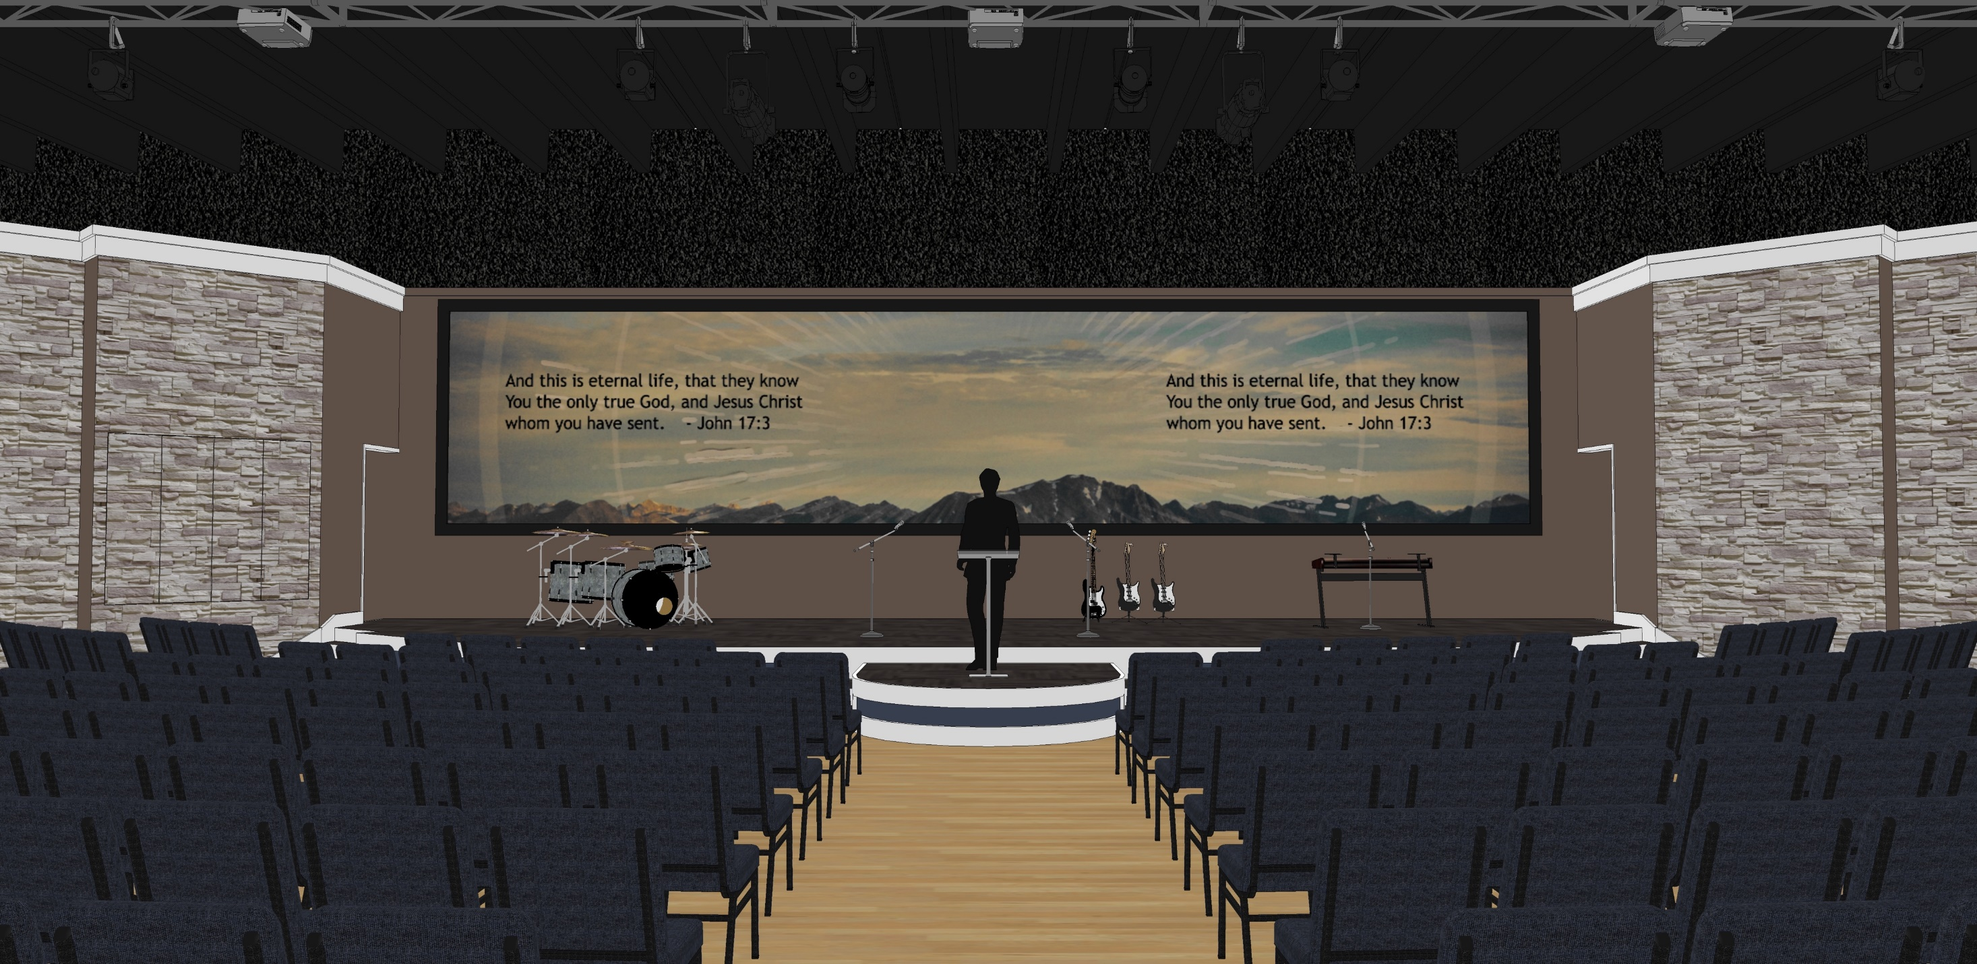
DBBC 2020

Slide 18
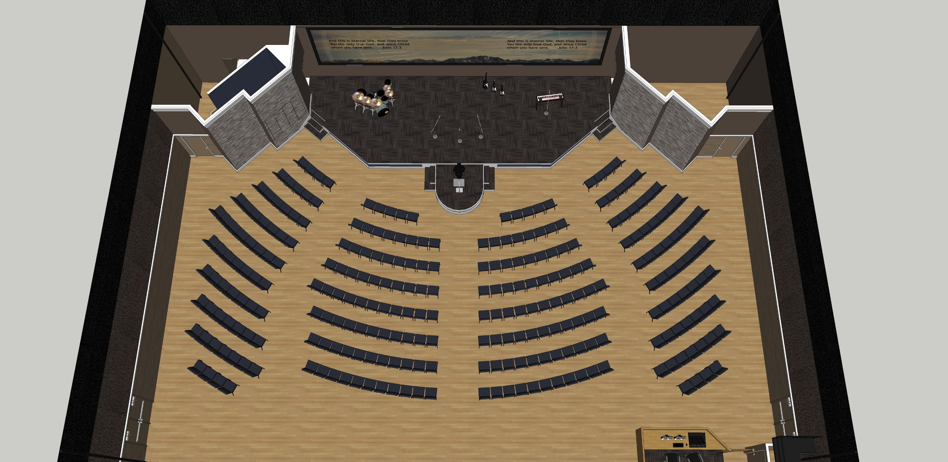
DBBC 2020

Slide 19
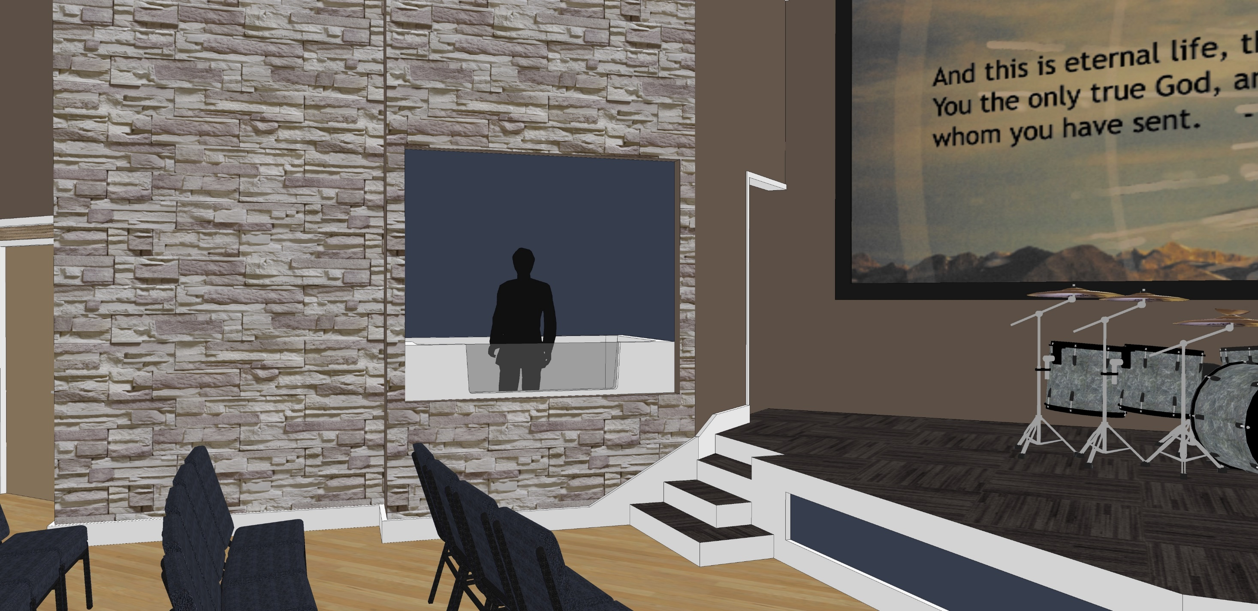
DBBC 2020

Slide 20
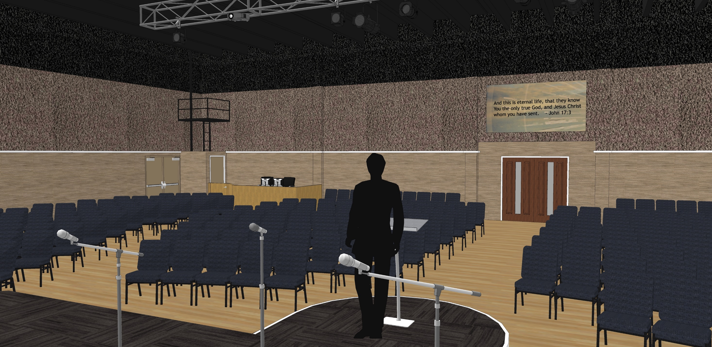
DBBC 2020

Slide 21
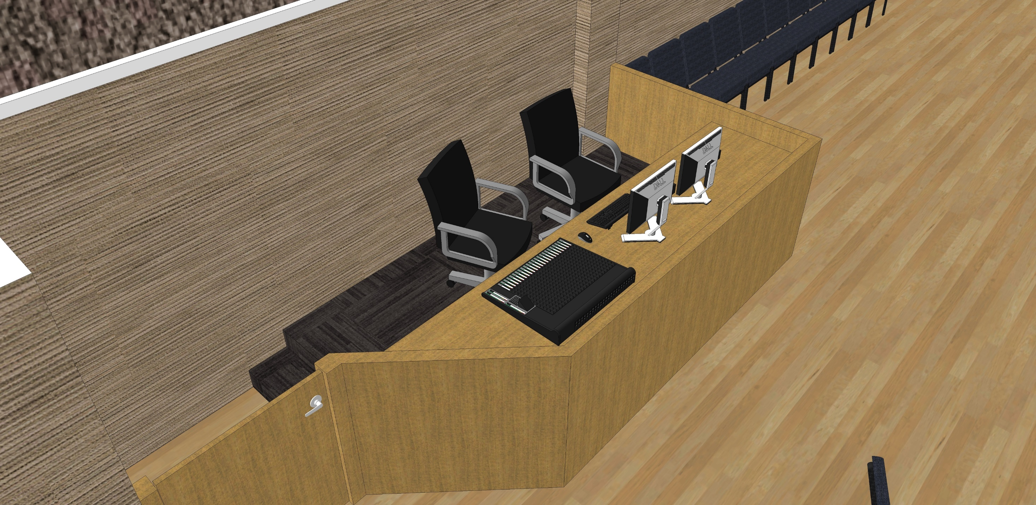
DBBC 2020

Slide 22
DBBC 2020
Commitment Sunday
January 29, 2017
Pray
Phase 1 Construction

Slide 23
DBBC 2020
Designated Fund
DBBC 2020

Slide 24
6 Month Commitment
DBBC 2020
Weekly | Monthly | Total
500 | 2,157 | 13,000
300 | 1,300 | 7,800
200 | 867 | 5,200
100 | 434 | 2,600
75 | 325 | 1,950
60 | 260 | 1,560
50 | 217 | 1,300
40 | 174 | 1,040
30 | 130 | 780
20 | 87 | 520
10 | 44 | 260
5 | 22 | 130

Slide 25
12 Month Commitment
DBBC 2020
Weekly | Monthly | Total
500 | 2,157 | 26,000
300 | 1,300 | 15,600
200 | 867 | 10,400
100 | 434 | 5,200
75 | 325 | 3,900
60 | 260 | 3,120
50 | 217 | 2,600
40 | 174 | 2,080
30 | 130 | 1,560
20 | 87 | 1,040
10 | 44 | 520
5 | 22 | 260

